Slide 1
Shallow Neural Network lab5
Eng: Samar Shaban

Slide 2
Problem: sonar Mines VS Rocks
Model : neural network
Performance matrix: Accuracy

Slide 3
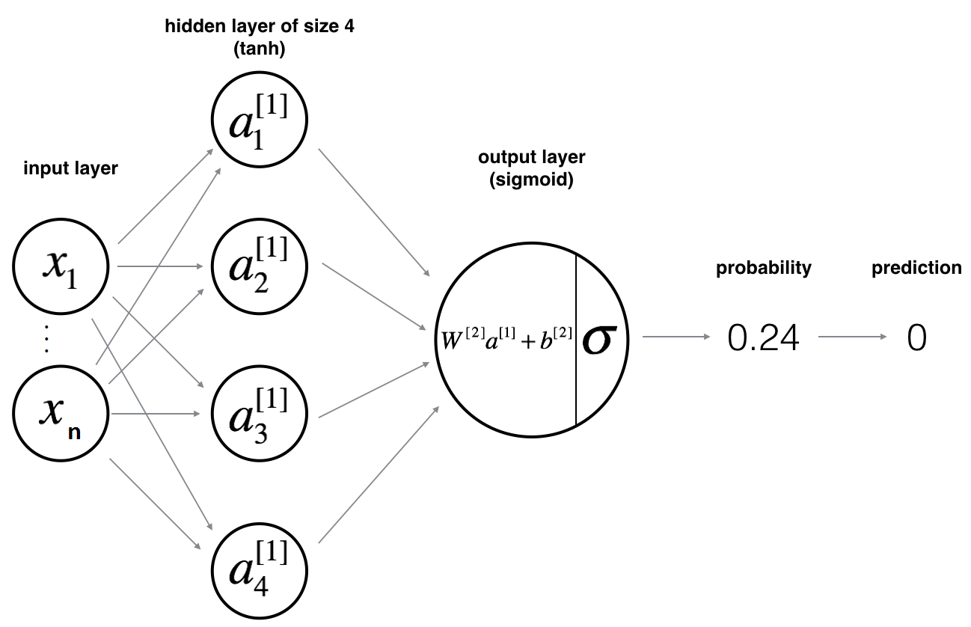

Slide 4
Define the neural network structure ( # of input units, # of hidden units, etc).
Initialize the model's parameters
Loop:
- Implement forward propagation
- Compute loss
- Implement backward propagation to get the gradients
- Update parameters (gradient descent)
➔merge steps from 1-3 into one function we call nn_model()

Slide 5
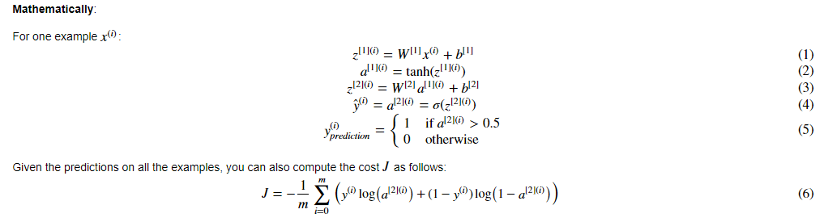

Slide 6
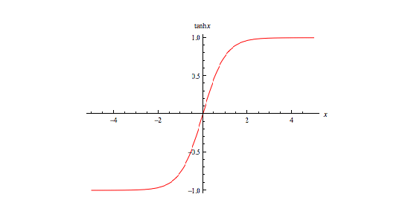
Hyperbolic Tangent: tanh
Tanh(x)= ( e^{x} - e^{-x} )/( e^{x} + e^{-x} )

Slide 7
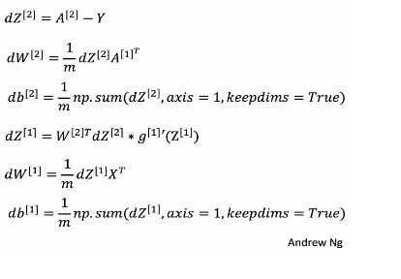
Gradient descent

